Slide 1
Unsupervised Learning: Word Embedding
Notes:
Preparing the demo
Extra topic:
maybe I can talk about relation extraction
Rest:
Paragraph vector
Introducing document vector
convolutional DSSM or parsing tree
Introducing the whole representation
Topic covered:
Motivation: meaning representation
Meaning of one word:
predict the next word
structure
How to train 1
why? What we get (done)
other structure 1
Meaning of a sentence:
Deep Semantic 1
+ convolution 1
Paragraph Vector 1
Outlook: parsing, composition

Slide 2
1-of-N Encoding
Word Embedding
apple = [ 1 0 0 0 0]
dog
bag = [ 0 1 0 0 0]
rabbit
run
cat = [ 0 0 1 0 0]
jump
cat
dog = [ 0 0 0 1 0]
tree
flower
elephant = [ 0 0 0 0 1]
Word Class
class 1
Class 2
Class 3
dog
ran
flower
cat
jumped
bird
walk
tree
apple

Slide 3
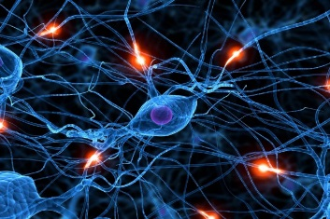

Word Embedding
Machine learn the meaning of words from reading a lot of documents without supervision
Word Embedding
tree
flower
dog
rabbit
run
jump
cat

Slide 4

Word Embedding
How about auto-encoder?
Generating Word Vector is unsupervised
Apple
Training data is a lot of text
Neural Network
?
https://garavato.files.wordpress.com/2011/11/stacksdocuments.jpg?w=490

Slide 5
Word Embedding
Machine learn the meaning of words from reading a lot of documents without supervision
A word can be understood by its context
You shall know a word by the company it keeps
蔡英文、馬英九 are something very similar
馬英九 520宣誓就職
蔡英文 520宣誓就職

Slide 6
How to exploit the context?
Count based
If two words w_{i} and w_{j} frequently co-occur, V(w_{i}) and V(w_{j}) would be close to each other
E.g. Glove Vector: http://nlp.stanford.edu/projects/glove/
Perdition based
V(w_{i}) . V(w_{j})
N_{i,j}
Inner product
Number of times w_{i} and w_{j} in the same document

Slide 7
Prediction-based
w_{i}
…… w_{i-2} w_{i-1} ___
0
z₁
1-of-N encoding
of the word w_{i-1}
1
z₂
The probability for each word as the next word w_{i}
0
……
……
…
……
Take out the input of the neurons in the first layer
z₂
tree
flower
Use it to represent a word w
dog
rabbit
run
jump
cat
Word vector, word embedding feature: V(w)
z₁
Notes:
Note that we only consider one input word, we only consider wi-1
We will consider multiple word
The structured is a little different

Slide 8
Prediction-based
You shall know a word by the company it keeps
0
z₁
1
z₂
The probability for each word as the next word w_{i}
0
……
……
蔡英文
or
馬英九
…
……
“宣誓就職” should have large probability
Training text:
z₂
…… 蔡英文 宣誓就職 ……
蔡英文
w_{i-1}
w_{i}
馬英九
…… 馬英九 宣誓就職 ……
w_{i-1}
w_{i}
z₁
Notes:
A man is known by the company he keeps.
觀其友知其人
Why the word vectors can probably capture the meaning of the words

Slide 9
Prediction-based – Sharing Parameters
0
z₁
1-of-N encoding
of the word w_{i-2}
1
z₂
The probability for each word as the next word w_{i}
0
……
……
…
0
The weights with the same color should be the same.
1-of-N encoding
of the word w_{i-1}
0
1
……
Or, one word would have two word vectors.
Notes:
Should I describe it more clearly?

Slide 10
Prediction-based – Sharing Parameters
0
z₁
1-of-N encoding
of the word w_{i-2}
1
W₁
z₂
The probability for each word as the next word w_{i}
0
……
……
…
z
x_{i-2}
0
The length of x_{i-1} and x_{i-2} are both |V|.
1-of-N encoding
of the word w_{i-1}
W₂
The length of z is |Z|.
1
z = W₁ x_{i-2} + W₂ x_{i-1}
0
……
The weight matrix W₁ and W₂ are both |Z|X|V| matrices.
x_{i-1}
z = W ( x_{i-2} + x_{i-1} )
W₁ = W₂
= W
Notes:
Should I describe it more clearly?
Can consider longer history

Slide 11
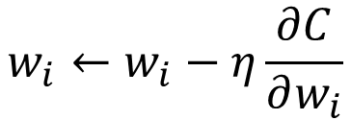

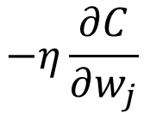
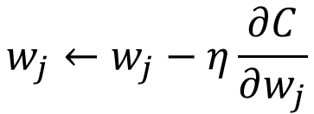
Prediction-based – Sharing Parameters
0
z₁
1-of-N encoding
of the word w_{i-2}
w_{i}
1
z₂
The probability for each word as the next word w_{i}
0
……
……
…
w_{j}
0
How to make w_{i} equal to w_{j}
1-of-N encoding
of the word w_{i-1}
Given w_{i} and w_{j} the same initialization
0
1
……
$$w_{i}←w_{i}−η\frac{∂C}{∂w_{i}}$$
$$−η\frac{∂C}{∂w_{j}}$$
$$w_{j}←w_{j}−η\frac{∂C}{∂w_{j}}$$
$$−η\frac{∂C}{∂w_{i}}$$
Notes:
We have talk about this concept in RNN
Should I describe it more clearly?
You can also do avg.
Pointer concept

Slide 12
Prediction-based – Training
潮水
Neural
Network
就
Collect data:
退了
潮水 退了 就 知道 誰 …
不爽 不要 買 …
公道價 八萬 一 …
………
退了
Neural
Network
知道
就
Minimizing cross entropy
就
Neural
Network
誰
知道
Notes:
What can it do? Application?

Slide 13
Prediction-based – Various Architectures
Continuous bag of word (CBOW) model
Skip-gram
w_{i-1}
Neural
Network
…… w_{i-1} ____ w_{i+1} ……
w_{i}
w_{i+1}
predicting the word given its context
…… ____ w_{i} ____ ……
Neural
Network
w_{i-1}
w_{i}
w_{i+1}
predicting the context given a word

Slide 14
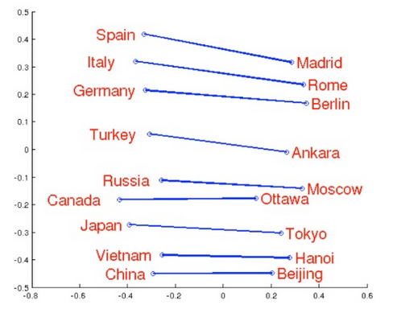
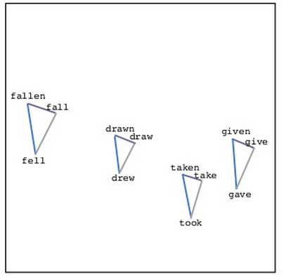
Word Embedding
Source: http://www.slideshare.net/hustwj/cikm-keynotenov2014
Notes:
Why can it happen
How to explain it

Slide 15
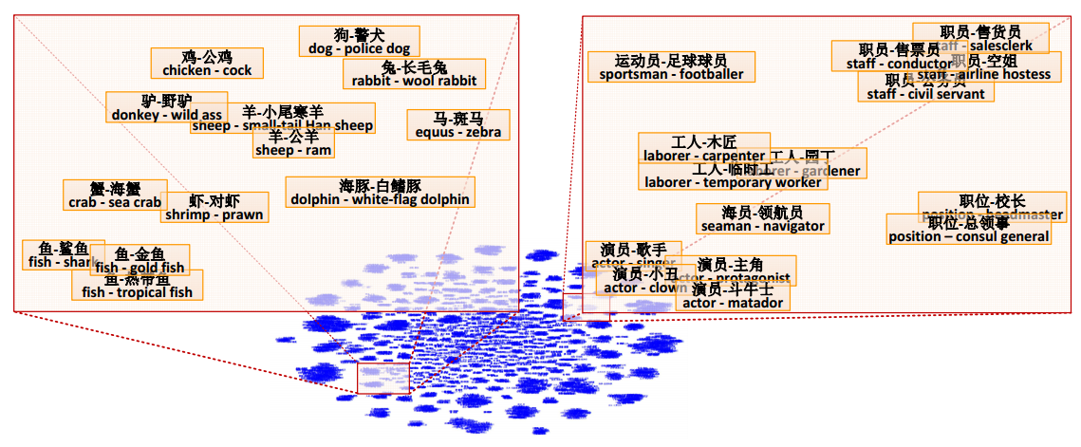
Word Embedding
Fu, Ruiji, et al. "Learning semantic hierarchies via word embeddings."Proceedings of the 52th Annual Meeting of the Association for Computational Linguistics: Long Papers. Vol. 1. 2014.

Slide 16
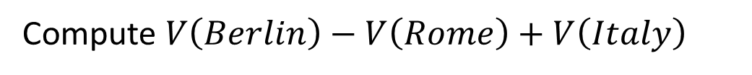
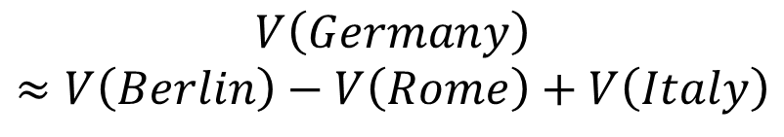
Word Embedding
$$V\left(Germany\right)$$
$$≈V\left(Berlin\right)−V\left(Rome\right)+V\left(Italy\right)$$
Characteristics
Solving analogies
$$V\left(hotter\right)−V\left(hot\right)≈V\left(bigger\right)−V\left(big\right)$$
$$V\left(Rome\right)−V\left(Italy\right)≈V\left(Berlin\right)−V\left(Germany\right)$$
$$V\left(king\right)−V\left(queen\right)≈V\left(uncle\right)−V\left(aunt\right)$$
Rome : Italy = Berlin : ?
Compute $V\left(Berlin\right)−V\left(Rome\right)+V\left(Italy\right)$
Find the word w with the closest V(w)
Notes:
Hierarchy is not mentioned …

Slide 17
Demo
Model used in demo is provided by 陳仰德
Part of the project done by 陳仰德、林資偉
TA: 劉元銘
Training data is from PTT (collected by 葉青峰)
Notes:
http://140.112.21.35:2880/~tlkagk/Word2Vec/
肥宅 八嘎囧 本魯
魯夫 海賊王 鳴人
魯蛇 loser 溫拿
魯蛇 窮 溫拿
研究生 期刊 漫畫家
本魯 廢宅 好棒 好棒棒
魯蛇 窮 溫拿
天 地 溫拿 魯蛇
天 地 專業課
研究生 期刊 漫畫家
找最相近詞: 廢宅 本魯 宅宅 好棒 好棒棒 魯夫 李逍遙 御坂美琴
A:B = C:?
魯夫 海賊王 鳴人
大學生 專題研究 忍者 忍術
大學生 專題研究 漫畫家 作品
天 地 溫拿 魯蛇
天 地 營養學分 專業課
忍者 查克拉 獵人 生命能量
忍者 查克拉 魯夫 橡膠果實
研究生 做實驗 漫畫家
魯夫 海賊王 鳴人
魯蛇 窮 溫拿

Slide 18
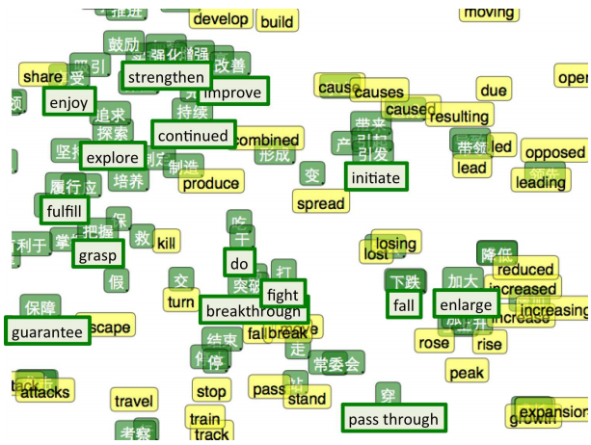
Multi-lingual Embedding
Bilingual Word Embeddings for Phrase-Based Machine Translation, Will Zou, Richard Socher, Daniel Cer and Christopher Manning, EMNLP, 2013
Notes:
Intuitively, it feels a bit like the two languages have a similar ‘shape’ and that by forcing them to line up at different points, they overlap and other points get pulled into the right positions.

Slide 19
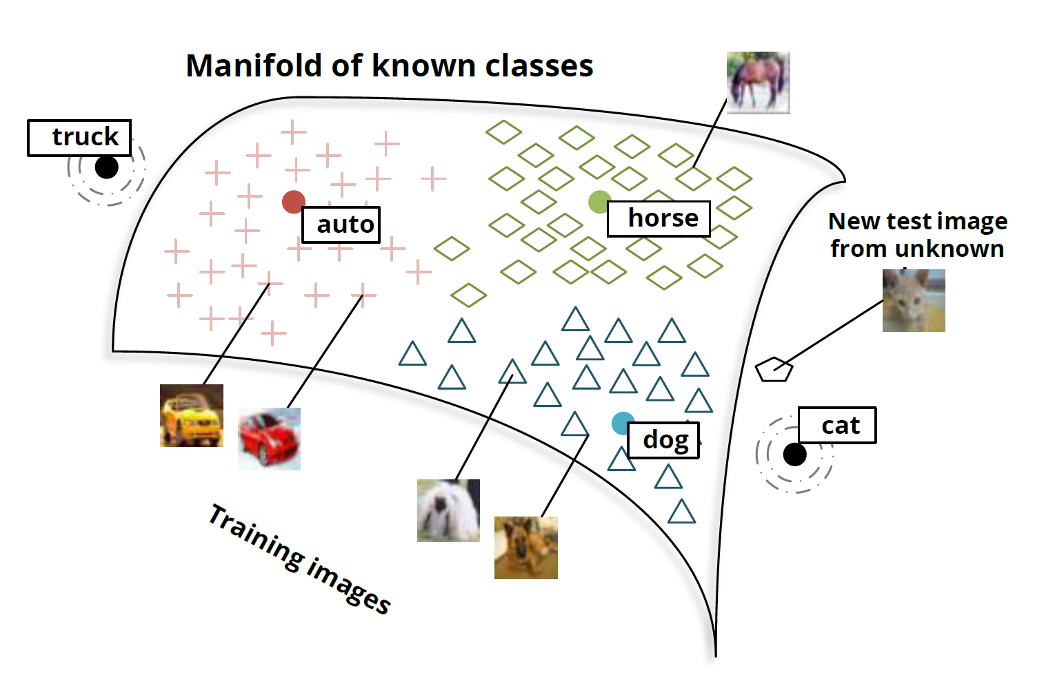
Multi-domain Embedding
Richard Socher, Milind Ganjoo, Hamsa Sridhar, Osbert Bastani, Christopher D. Manning, Andrew Y. Ng, Zero-Shot Learning Through Cross-Modal Transfer, NIPS, 2013
Notes:
Deep walk
https://arxiv.org/pdf/1403.6652v2.pdf
word2vec 中的數學原理詳解（一）目錄和前言
http://blog.csdn.net/itplus/article/details/37969519
http://colah.github.io/posts/2014-07-NLP-RNNs-Representations/

Slide 20

Document Embedding
word sequences with different lengths → the vector with the same length
The vector representing the meaning of the word sequence
A word sequence can be a document or a paragraph
…
word sequence
(a document or paragraph)
Notes:
The meaning of word is ambiguous
It can be easy for a document

Slide 21
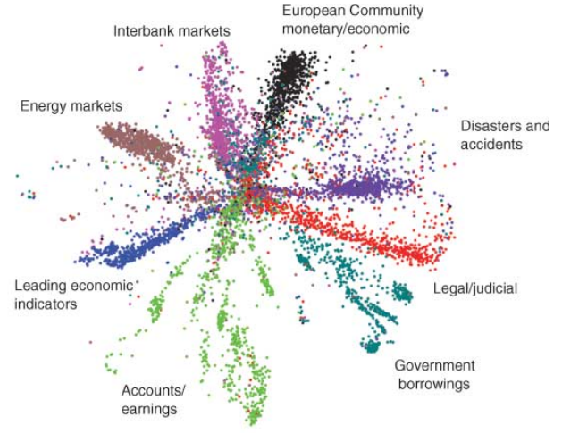
Semantic Embedding
Reference: Hinton, Geoffrey E., and Ruslan R. Salakhutdinov. "Reducing the dimensionality of data with neural networks." Science 313.5786 (2006): 504-507
Bag-of-word
Notes:
Auto-encoder is another approach
The qeruy not always have the common word

Slide 22
Beyond Bag of Word
To understand the meaning of a word sequence, the order of the words can not be ignored.
white blood cells destroying an infection
positive
different
meaning
exactly the same bag-of-word
an infection destroying white blood cells
negative
Notes:
傳染病 infection

Slide 23
Beyond Bag of Word
Paragraph Vector: Le, Quoc, and Tomas Mikolov. "Distributed Representations of Sentences and Documents.“ ICML, 2014
Seq2seq Auto-encoder: Li, Jiwei, Minh-Thang Luong, and Dan Jurafsky. "A hierarchical neural autoencoder for paragraphs and documents." arXiv preprint, 2015
Skip Thought: Ryan Kiros, Yukun Zhu, Ruslan Salakhutdinov, Richard S. Zemel, Antonio Torralba, Raquel Urtasun, Sanja Fidler, “Skip-Thought Vectors” arXiv preprint, 2015.
Exploiting other kind of labels:
Huang, Po-Sen, et al. "Learning deep structured semantic models for web search using clickthrough data." ACM, 2013.
Shen, Yelong, et al. "A latent semantic model with convolutional-pooling structure for information retrieval." ACM, 2014.
Socher, Richard, et al. "Recursive deep models for semantic compositionality over a sentiment treebank." EMNLP, 2013.
Tai, Kai Sheng, Richard Socher, and Christopher D. Manning. "Improved semantic representations from tree-structured long short-term memory networks." arXiv preprint, 2015.
Notes:
word2vec 中的數學原理詳解（一）目錄和前言
http://blog.csdn.net/itplus/article/details/37969519

